Slide 1
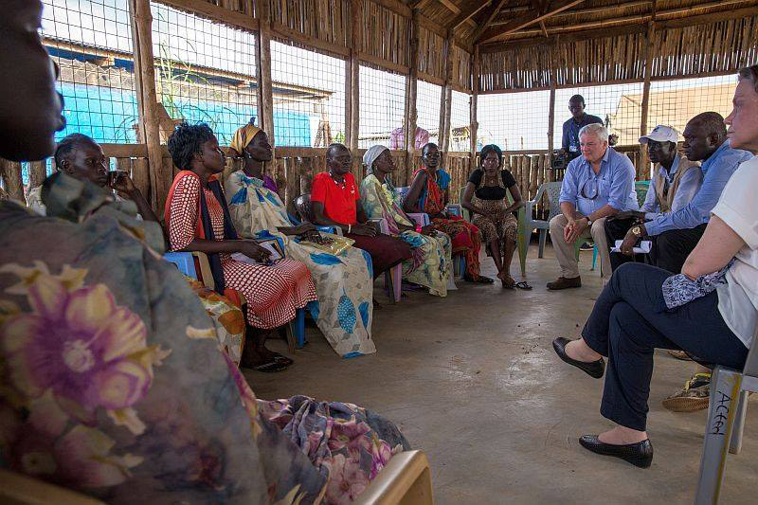
Learning Activity 2.4.3
Image 1
UN Core Pre-Deployment Training Materials 2017

Slide 2
Learning Activity 2.4.3
Image 2
UN Core Pre-Deployment Training Materials 2017

Slide 3
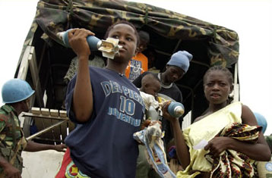
Learning Activity 2.4.3
Image 3
UN Core Pre-Deployment Training Materials 2017

Slide 4
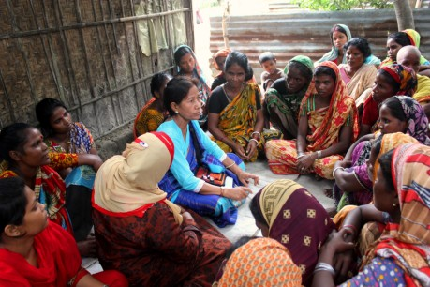
Learning Activity 2.4.3
Image 4
UN Core Pre-Deployment Training Materials 2017

Slide 5
Learning Activity 2.4.3
Image 5
UN Core Pre-Deployment Training Materials 2017

Slide 6
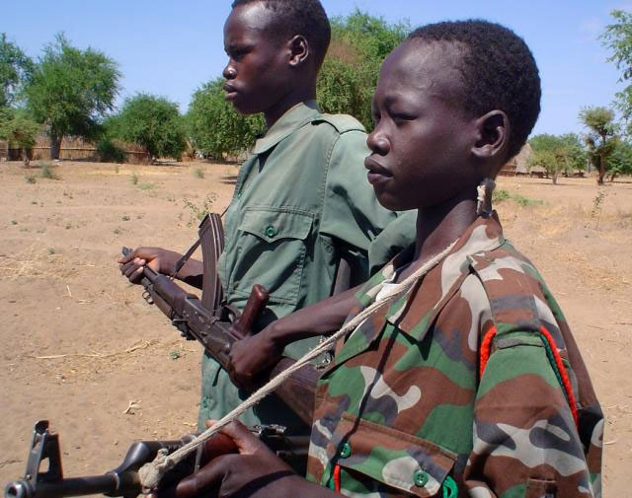
Learning Activity 2.4.4
Scenario 1
You are deployed to a UN peacekeeping mission. You work with ex-combatants. How would you integrate the concerns and experiences of women and girls?
UN Core Pre-Deployment Training Materials 2017

Slide 7
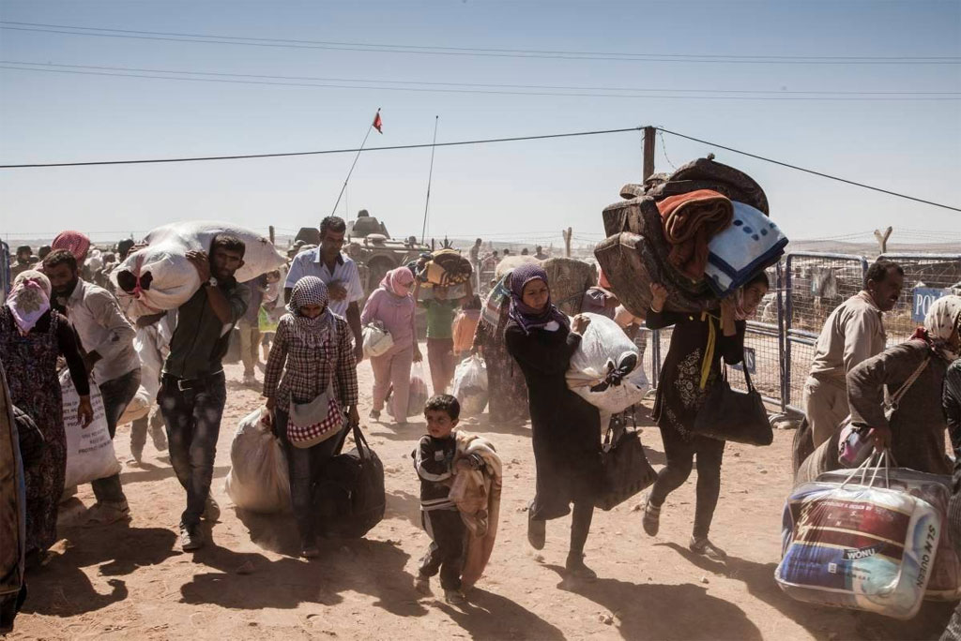
Learning Activity 2.4.4
Scenario 2
You are deployed to a UN peacekeeping mission. You work with refugees and internally displaced persons. How would you integrate the concerns and experiences of women and girls?
UN Core Pre-Deployment Training Materials 2017

Slide 8
Learning Activity 2.4.4
Scenario 3
You are deployed to a UN peacekeeping mission. You work on rule of law activities. How would you integrate the concerns and experiences of women and girls?
UN Core Pre-Deployment Training Materials 2017

Slide 9
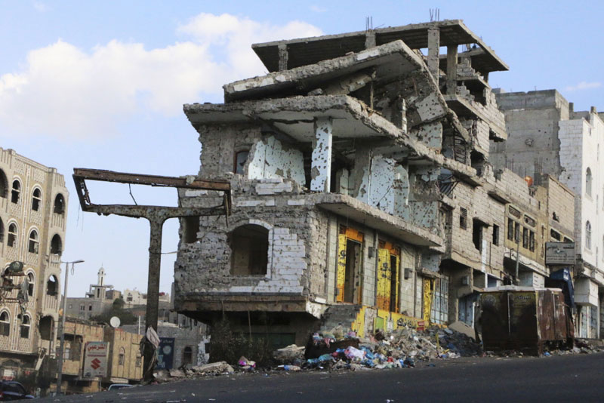
Learning Activity 2.4.4
Scenario 4
You are deployed to a UN peacekeeping mission. You support economic opportunities. How would you integrate the concerns and experiences of women and girls?
UN Core Pre-Deployment Training Materials 2017

Slide 10
Learning Activity 2.4.7
Image 1
The fox invited the crane to dinner. He served soup on two large, flat plates.
The crane with its long, narrow beak could not eat. She could only get the end of her beak wet.
UN Core Pre-Deployment Training Materials 2017

Slide 11
Learning Activity 2.4.7
Image 2
Later, the crane invited the fox to dine. She served the food in a deep vase. The fox with his short, wide face could not eat.
Both had an equal opportunity for nourishment, but at each meal, one was not able to take advantage of the opportunity. (So it was not a real opportunity).
UN Core Pre-Deployment Training Materials 2017

